Slide 1
React Components
P.N.V. Sumanasree
22H51A0544
CSE-D

Slide 2
Introduction to React Components
React components are the building blocks of any React application.
They allow developers to create reusable UI elements for better maintainability.
Understanding components is essential for efficient React development.
1
Notes:
Image source: https://www.educba.com/react-components/?source=leftnav

Slide 3
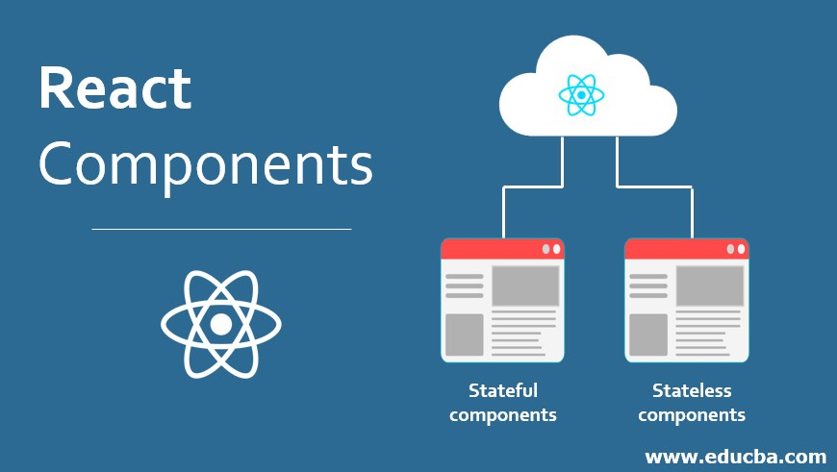
Types of React Components
There are two main types of components: functional and class components.
Functional components are simpler and are preferred for most use cases.
Class components provide additional features like lifecycle methods and state management.
2
Notes:
Image source: https://www.educba.com/react-components/

Slide 4
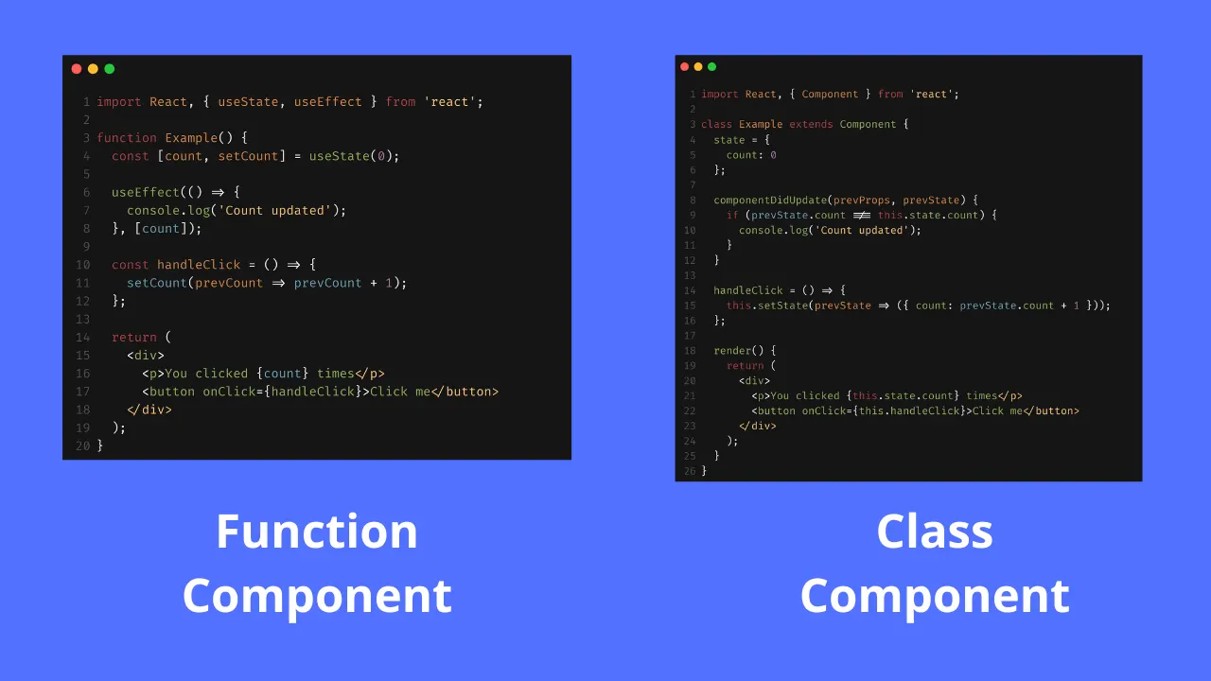
Functional Components Explained
Functional components are JavaScript functions that return JSX.
They can accept props and render UI based on those props.
React hooks can be utilized within functional components to manage state and side effects.
3
Notes:
Image source: https://josipmisko.com/posts/react-functional-vs-class-components

Slide 5
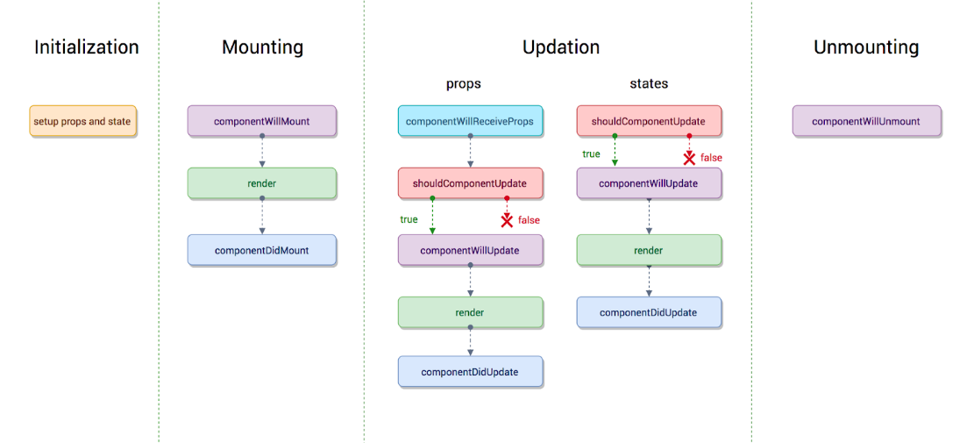
Class Components Explained
Class components extend from the React.Component class and have access to lifecycle methods.
They use a render method to return JSX and can maintain their own state.
Class components are less commonly used in modern React development due to the rise of hooks.
4
Notes:
Image source: https://composantsdordinateurportable.blogspot.com/2021/08/class-component-lifecycle-in-react.html

Slide 6
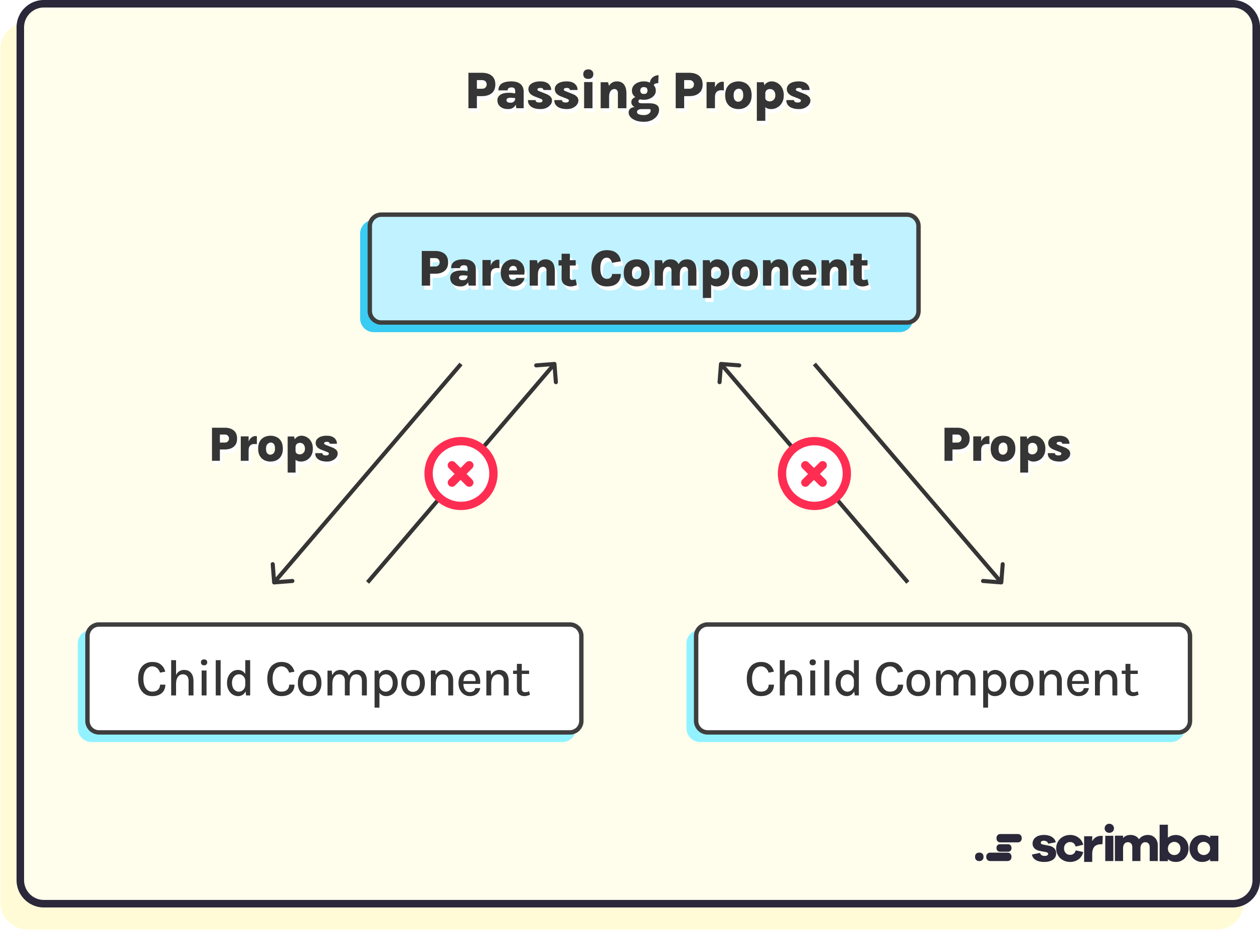
Props in React Components
Props are used to pass data from parent components to child components.
They are read-only and help in creating dynamic and reusable components.
Understanding how to effectively use props is crucial for component communication.
5
Notes:
Image source: https://scrimba.com/articles/react-props/

Slide 7
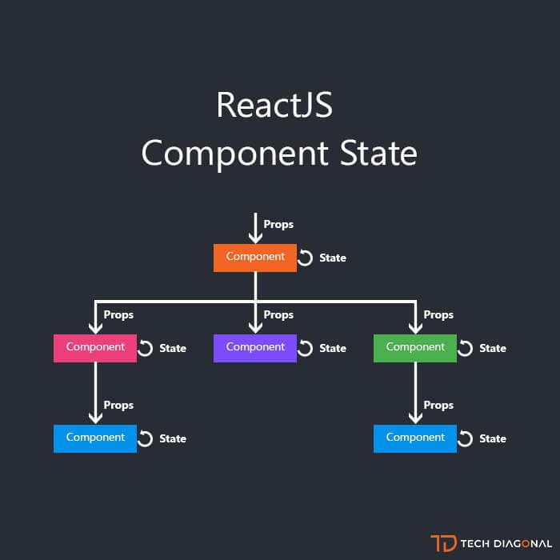
State in React Components
State is an internal data structure that determines a component's behavior and rendering.
Class components manage state using this.setState(), while functional components use the useState hook.
Proper state management is essential for building responsive and interactive applications.
6
Notes:
Image source: https://www.pinterest.co.uk/pin/what-is-reactjs-state-this-chapter-introduces-reactjs-state-state-is-an-updatable-obj--773493304741939384/

Slide 8

Lifecycle Methods
Lifecycle methods are special methods in class components that allow control over component behavior.
Common lifecycle methods include componentDidMount, componentDidUpdate, and componentWillUnmount.
Understanding lifecycle methods is key to managing side effects and optimizing performance.
7
Notes:
Image source: https://www.vrogue.co/post/the-react-lifecycle-methods-and-hooks-explained

Slide 9
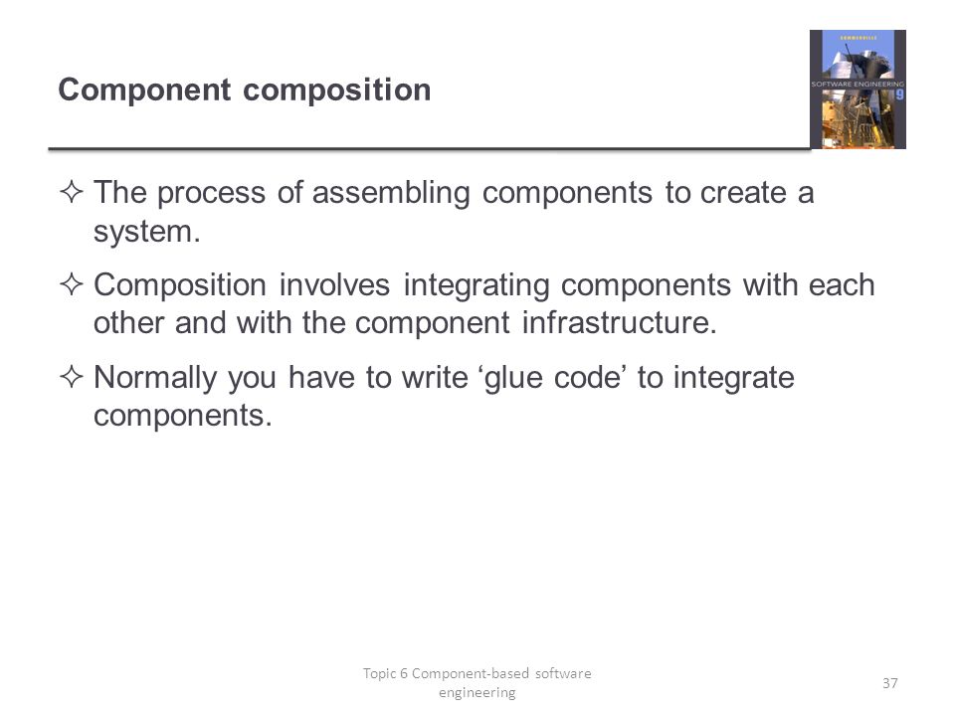
Component Composition
Component composition involves combining multiple components to create a more complex UI.
This practice promotes reusability and separation of concerns within an application.
Higher-Order Components (HOCs) and render props are advanced techniques for component composition.
8
Notes:
Image source: https://slideplayer.com/slide/6866431/

Slide 10
THANK YOU

